Slide 1

Cloud Services

Slide 2
Core Cloud Service Categories
Cloud Compute Services
Cloud Networking Services
Cloud Storage Services
Cloud Security, Identity, and Compliance Services
Cloud Analytics Services
Cloud Database Services

Slide 3
Core Cloud Service Categories
Cloud Compute Services
Cloud Networking Services
Cloud Storage Services
Cloud Security, Identity, and Compliance Services
Cloud Analytics Services
Cloud Database Services

Slide 4
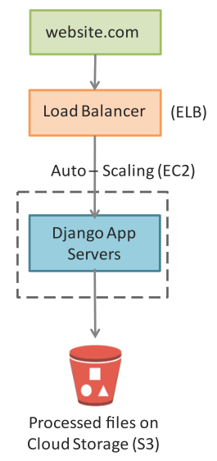
Compute service in Image Processing App

Slide 5
Core Cloud Service Categories
Cloud Compute Services
Cloud Networking Services
Cloud Storage Services
Cloud Security, Identity, and Compliance Services
Cloud Analytics Services
Cloud Database Services

Slide 6
Networking service in Image Processing App

Slide 7
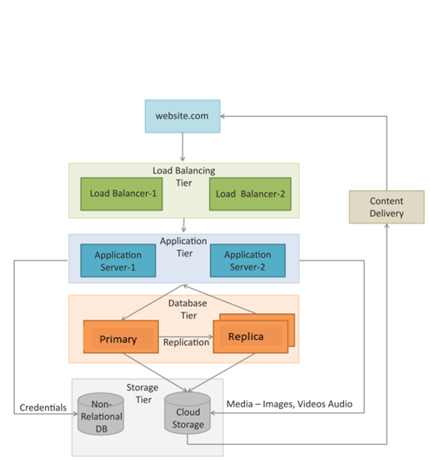
Networking service in Content delivery app
A content delivery network (CDN) which consists of a global network of edge locations is used for media delivery.
CDN is used to speed up the delivery of static content such as images and videos.

Slide 8
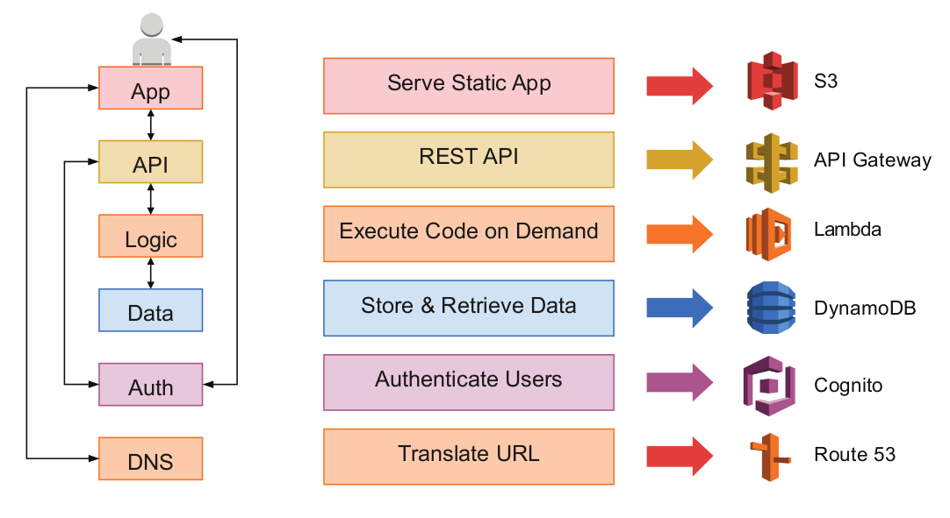
Networking Services - Serverless Applications
Example of a multi-tier web application implemented with the serverless computing model.

Slide 9
Cloud Service Categories
Cloud Compute Services
Cloud Networking Services
Cloud Storage Services
Cloud Security, Identity, and Compliance Services
Cloud Analytics Services
Cloud Database Services

Slide 10
Cloud Storage Services

Slide 11
Overview
Cloud Storage types
Amazon S3
Amazon EFS
Amazon EBS
AWS Storage Gateway

Slide 12
Overview
Cloud Storage types
Amazon S3
Amazon EFS
Amazon EBS
AWS Storage Gateway

Slide 13
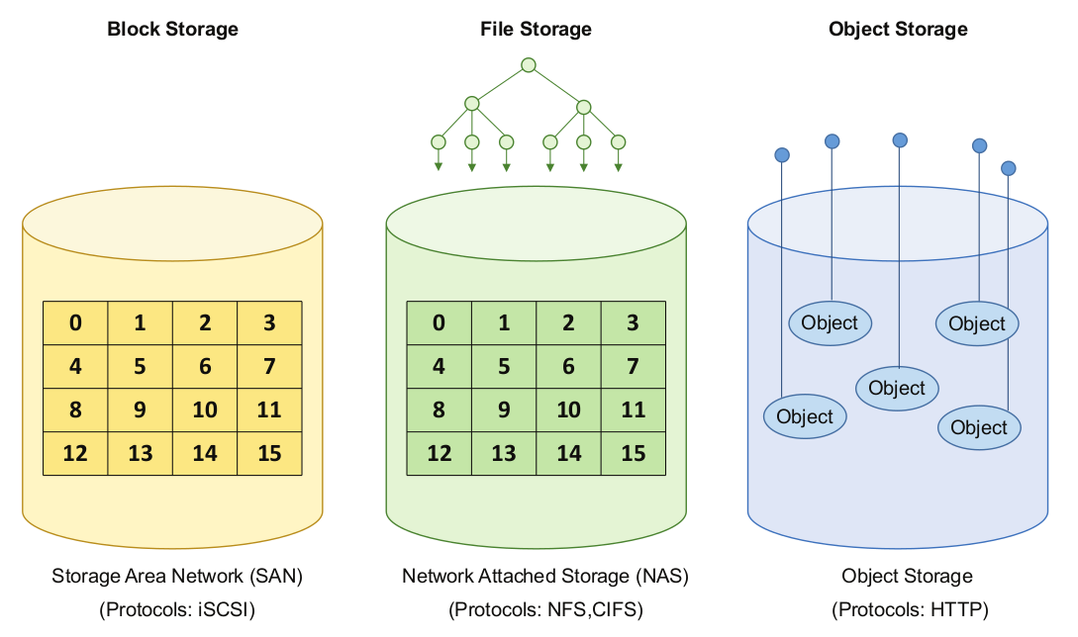
Storage Types
In cloud computing environments, three types of storage solutions are offered:
Block storage
File storage
Object storage

Slide 14
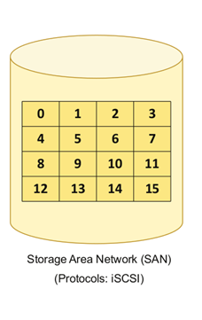
Block Storage
Block storage operates at the operating system kernel level, and the data is stored and organized as an array of unrelated blocks.
In Block storage, the data is stored without any concept of data format or type.
Block storage is accessed over the network as a Storage Area Network (SAN) using protocols such as iSCSI.

Slide 15
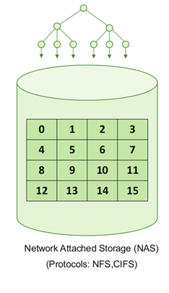
File Storage
File storage operates at the operating system user level, and the data is stored as data blocks which are managed by a file system.
In file storage, data is managed as a named hierarchy of files and folders.
Files have meta-data associated with them (such as file name, type, and creation date).
File storage is accessed over the network as a Network Attached Storage (NAS) using protocols such as Network File System (NFS) or Common Internet File System (CIFS).

Slide 16
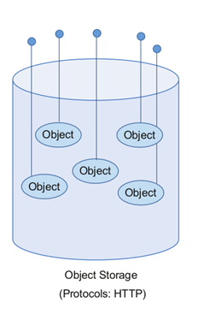
Object Storage
Object storage operates at the application level, and the data is stored as objects.
Each object consists of an object identifier (OID), data, and meta-data.
Object storage is accessed with protocols such as HTTP using REST APIs.

Slide 17
Cloud storage types
Each type of storage has its own characteristics and is suitable for specific use cases.
File storage is organized hierarchically for easy human access
Object storage is designed for large-scale and unstructured data
Block storage provides raw, high-performance storage for applications.

Slide 18

Overview
Cloud Storage types
Amazon S3
Amazon EFS
Amazon EBS
AWS Storage Gateway

Slide 19

Amazon Simple Storage Service (S3)
Amazon Simple Storage Service(S3) is an online cloud-based data storage infrastructure for storing and retrieving any amount of data.
S3 provides a highly reliable, scalable, fast, fully redundant, and affordable storage infrastructure.
S3 is a cloud object storage service.
You need to create a bucket before you can store data on S3
S3 console provides simple wizards for creating a new bucket and uploading files.
You can upload any type of file to S3.
While uploading a file, you can specify the redundancy and encryption options and access permissions.
Data stored on S3 is independent of any server and is accessed over the Internet using the S3 web interface or console, S3 REST APIs or using the AWS SDKs.

Slide 20
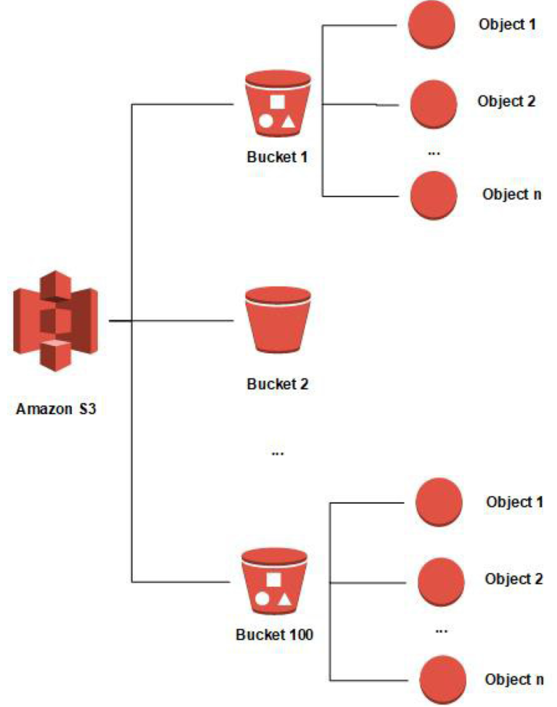
S3 Storage
A bucket is a high-level container that organizes and holds objects, while an object is the actual data unit stored within a bucket.
Buckets provide a way to manage and organize objects, and objects store the actual content, along with metadata

Slide 21
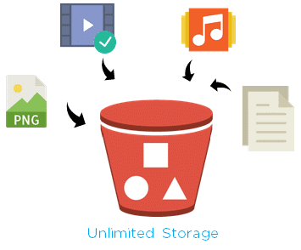
S3 Buckets
Data stored on S3 is organized in the form of buckets.
While creating a bucket, a bucket name is provided.
The bucket name has to be unique across all AWS accounts, and not just within your AWS account.
An S3 bucket is created for a specific region.
By selecting a region for the bucket, you can control where your data is stored.

Slide 22
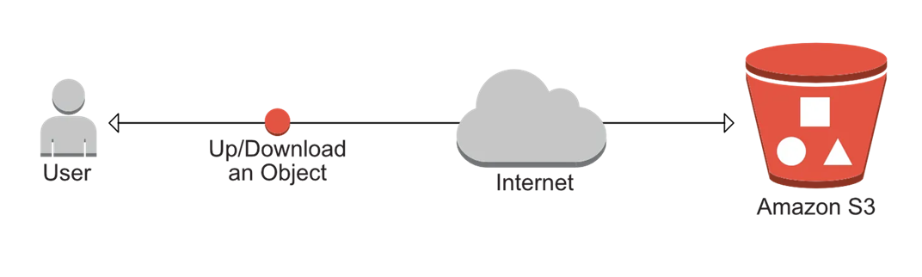
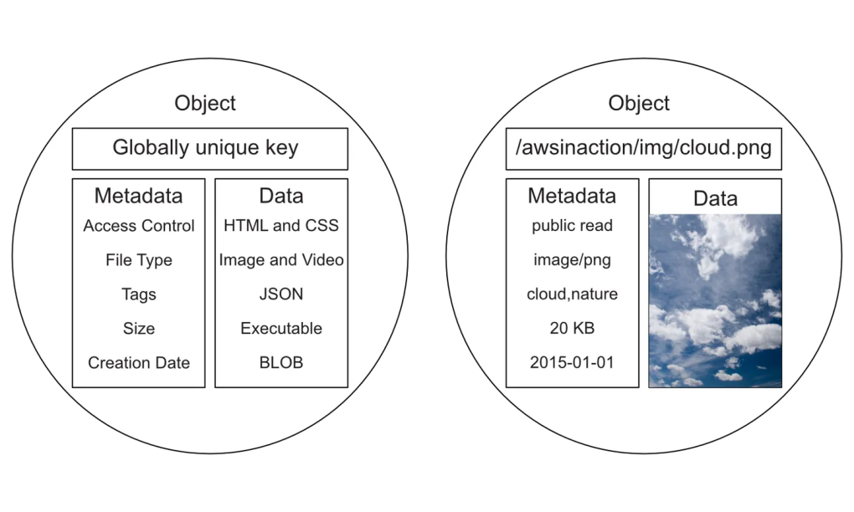
S3 Objects
Objects are the entities which are stored in Amazon S3
Objects have object data and meta-data
The Metadata for an object consists of a set of key-value pairs which provide information regarding the object
Objects can store data in any format, and the data stored is opaque to S3

Slide 23
S3 Objects
Objects size can range from 0 bytes to 5TB.
An object consists of a Key, Version ID, Value, Meta-data, Subresources, and Access Control Information.
Key is the name that is assigned to the object.
You can use versioning to keep multiple versions of the same object in a bucket.
Version ID allows you to identify a specific version of an object.
The Value of an object is the actual content which you store. Value is a sequence of bytes.

Slide 24
S3 Bucket Policies and ACLs
By default, access to all resources in S3, including buckets and objects is private.
You can manage access to the S3 resources using
resource-based policies
user-based policies

Slide 25
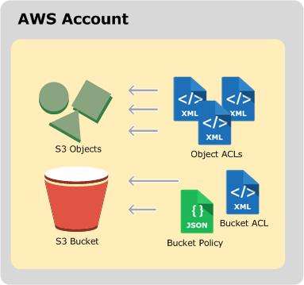
Resource-based policies
Resource-based policies include bucket policies and access control lists (ACLs)).
An ACL defines which AWS accounts or groups are granted access and the type of access such as READ, WRITE, READ_ACP, WRITE_ACP, and FULL_CONTROL.
Access Control Lists (ACLs) allow you to grant permissions such as read or write at the level of a bucket or object.

Slide 26
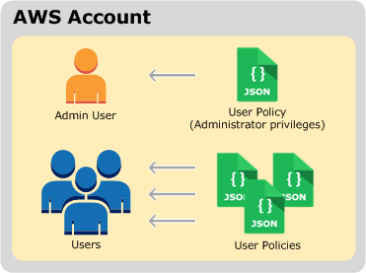
User-based policies
User-based policies include AWS Identity and Access Management (IAM) policies attached to users in an AWS account.
You can create IAM users, groups, and roles in your account and attach access policies to them granting them access to AWS resources, including Amazon S3.

Slide 27
Cross-Origin Resource Sharing (CORS) in S3
Cross-Origin Resource Sharing (CORS) is a mechanism that allows a client application running at one origin (domain) to have permission to access selected resources from a different origin (domain).
You can enable CORS for an S3 bucket using the Amazon S3 console, or by using the Amazon S3 REST API and the AWS SDKs.
To allow cross-origin requests, a CORS configuration is created. A CORS configuration specifies rules such as the origins which are allowed to access a bucket, the allowed operations or HTTP methods, and other operation-specific information.

Slide 28
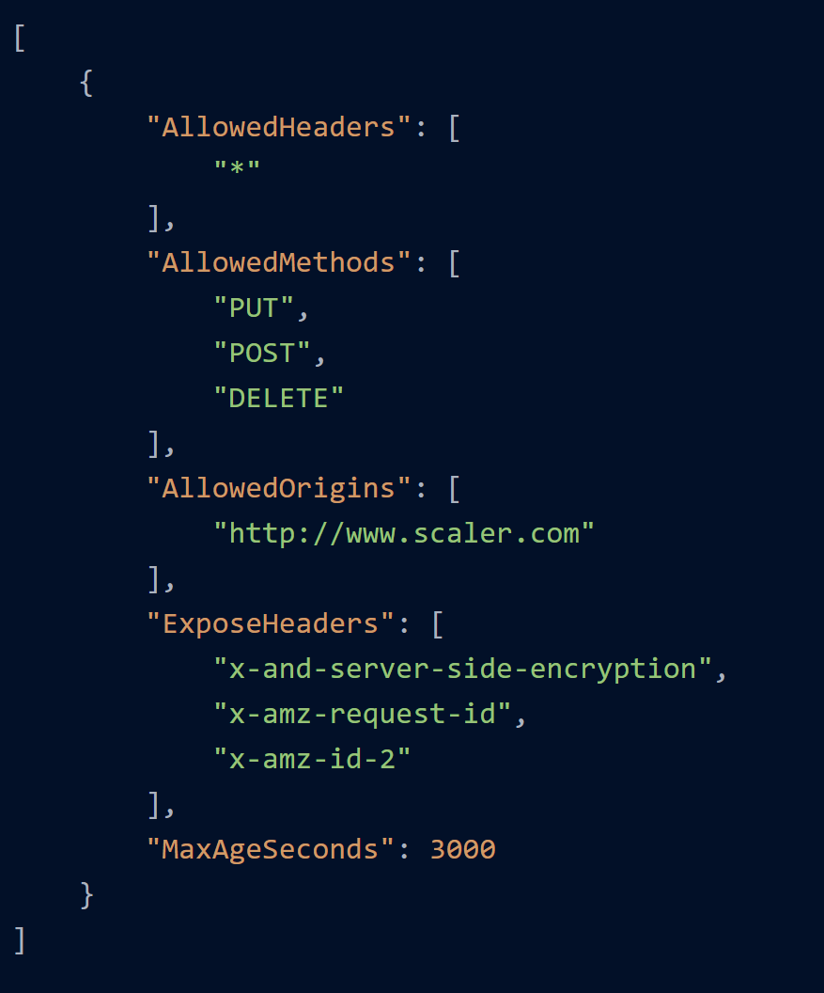
CORS in S3 example
PUT, POST, and DELETE methods are allowed from cross-origin requester www.scaler.com

Slide 29
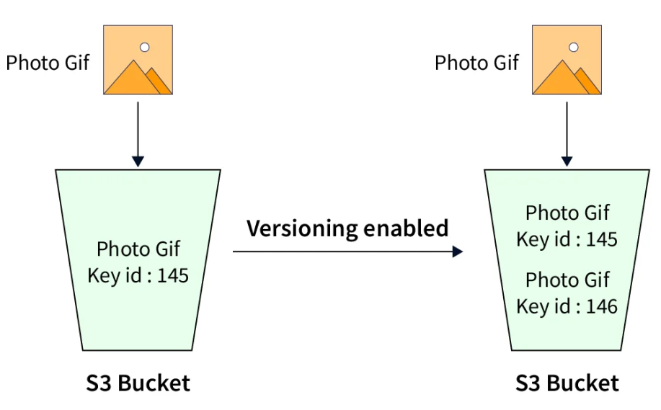
Versioning in S3
S3 allows you to enable versioning for a bucket.
When versioning is enabled, you can have multiple versions of an object in one bucket.
Versioning helps in protecting your data from accidental or malicious updates or deletes.
Each version is identified by a version ID.
You can retrieve and restore every version of every object stored in a bucket for which versioning is enabled.
Versioning is enabled at the bucket level and once enabled, it cannot be disabled, but can only be suspended.
A bucket in which versioning is enabled maintains one current and zero or more noncurrent object versions.

Slide 30
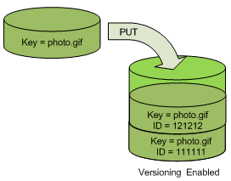
Versioning example
For example, in one bucket you can have two objects with the same key (object name) but different version IDs, such as photo.gif (version 111111) and photo.gif (version 121212).
When you PUT an object in a versioning-enabled bucket, the noncurrent version is not overwritten
when a new version of photo.gif is PUT into a bucket that already contains an object with the same name, the following behavior occurs:
The original object (ID = 111111) remains in the bucket.
Amazon S3 generates a new version ID (121212), and adds this newer version of the object to the bucket.

Slide 31
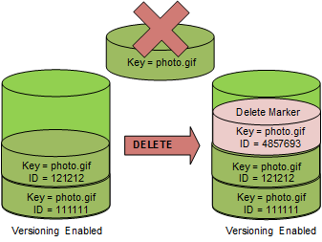
Versioning example - cont.
When you DELETE an object, all versions remain in the bucket, and Amazon S3 inserts a delete marker
The delete marker becomes the current version of the object.

Slide 32
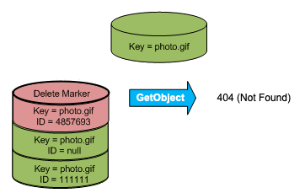
Versioning example - cont.
By default, GET requests retrieve the most recently stored version. Performing a GET Object request when the current version is a delete marker returns a 404 Not Found error

Slide 33
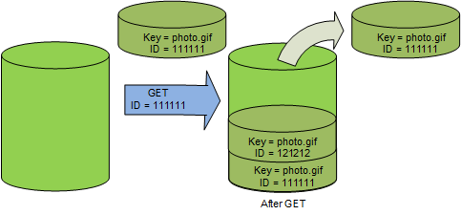
Versioning example - cont.
You can GET a noncurrent version of an object by specifying its version ID. In the following figure, you GET a specific object version, 111111. Amazon S3 returns that object version even though it's not the current version.

Slide 34
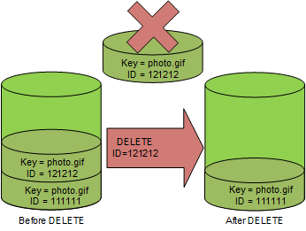
Versioning example - cont.
You can permanently delete an object by specifying the version that you want to delete.
Only the owner of an Amazon S3 bucket can permanently delete a version.
If your DELETE operation specifies the version Id, that object version is permanently deleted, and Amazon S3 doesn't insert a delete marker.

Slide 35
Encryption in S3
You can protect sensitive data stored in S3 using encryption.
You can either use Server-Side Encryption (SSE) or Client-Side Encryption for protecting data at rest in S3.
With server-side encryption, S3 encrypts the data at the object level before saving it on disks in its data centers and decrypts it when you download the objects.
S3 provides three options for SSE depending on how you choose to manage the encryption keys:
SSE-S3 (Server-Side Encryption with Amazon S3-Managed Keys)
SSE-KMS (Server-Side Encryption with AWS KMS-Managed Keys)
SSE-C (Server-Side Encryption with Customer-Provided Keys)

Slide 36

Transfer Acceleration in S3
You can enable Transfer Acceleration for a bucket to enable fast, easy, and secure transfers of files over long distances between your client and the S3 bucket.

Slide 37
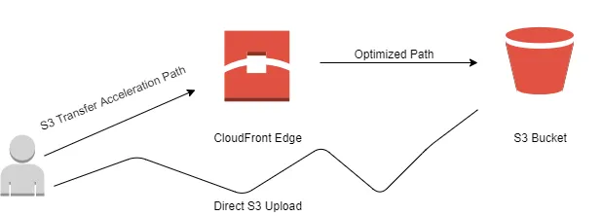
Transfer Acceleration in S3
Transfer Acceleration feature in S3 uses the globally distributed edge locations of Amazon CloudFront to route data from an edge location to S3 over an optimized path.

Slide 38
S3 Durability and Availability
A durable storage system ensures that the data stored is not lost due to corruption or degradation.
An available storage system is one that continues to remain operational and can deliver data when requested.
S3 is designed for 99.999999999% (eleven nines) of durability and 99.99% availability.
S3 provides such high durability of data by storing data redundantly on multiple systems in multiple facilities within a region.

Slide 39
S3 Storage Classes
S3 offers various storage classes which are designed for different use cases and differ in the durability and availability:
Standard: Standard storage class is designed for frequently accessed data and offers high durability (99.999999999%), high availability (99.99%), low latency, and high throughput.
Standard - Infrequently Accessed: Standard - Infrequently Accessed (IA) storage class offers the high durability (99.999999999%) and availability (99.9%) like the Standard storage class, but it is designed for long-lived and infrequently accessed data.
Intelligent Tiering: Intelligent Tiering storage class offers high durability (99.999999999%) and availability (99.9%) and is designed for long-lived data with changing or unknown access patterns.
One Zone - Infrequently Accessed: One Zone - Infrequently Accessed (IA) storage class offers high durability (99.999999999%) and a slightly lower availability (99.5%).
Glacier: Glacier storage class offers the same durability and availability as the Standard storage class but at extremely low-cost. Glacier is designed for long-term data archiving with retrieval times ranging from minutes to hours.
Reduced Redundancy: Reduced Redundancy storage class offers slightly lower durability (99.99%) and high availability (99.99%).

Slide 40
S3 Consistency – before 2020
S3 provides read-after-write consistency for PUTS of new objects
Whereas for PUTS to existing objects and for object DELETES, S3 offers eventual consistency
Eventual consistency for overwrite PUTS means that if you update an object with a PUT request, and then read the object with a GET request, you can either get the old data or updated data.
Similarly, eventual consistency for DELETES means that if you delete an object and then read the object with a GET request, you can still read the deleted object. However, updates to a single key are atomic.

Slide 41
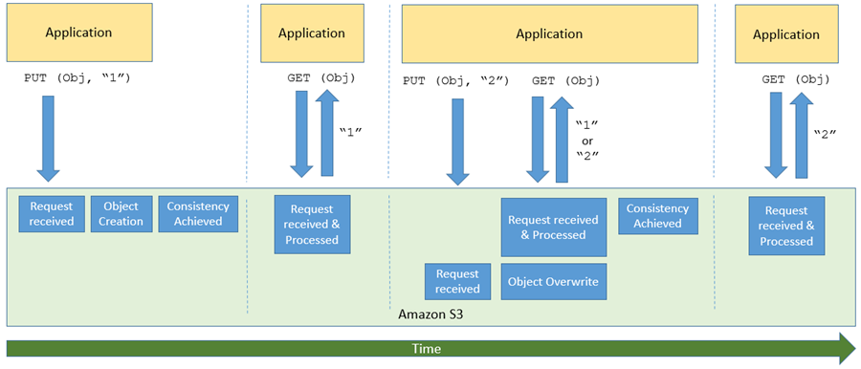
Eventual consistency for overwrite PUTS

Slide 42
Read-after-write consistency
"strong consistency" ensures that if a write operation is successful, any subsequent read operation will reflect that write.
In other words, once a write is acknowledged, any subsequent reads will return the most recent version of the data.

Slide 43
Eventual Consistency
a weaker form of consistency that allows for temporary inconsistencies between replicas of data
In an eventually consistent system, there is no guarantee that a read operation immediately reflects the most recent write.
However, over time, all replicas will catch up, and the system will reach a consistent state.

Slide 44
Read-after-write consistency vs Eventual Consistency
Availability:
Read-after-write consistency may lead to reduced availability, especially in the presence of network partitions or node failures.
Eventual consistency prioritizes availability, ensuring that the system remains operational even when nodes are temporarily isolated

Slide 45
S3 Consistency – after December 2020
Amazon S3 provides strong read-after-write consistency for PUT and DELETE requests of objects in your Amazon S3 bucket in all AWS Regions.
This behavior applies to both writes to new objects as well as PUT requests that overwrite existing objects and DELETE requests.
In addition, read operations on Amazon S3 Select, Amazon S3 access controls lists (ACLs), Amazon S3 Object Tags, and object metadata (for example, the HEAD object) are strongly consistent.
…but, there are still edge cases

Slide 46
Concurrent applications
When multiple clients are writing to the same items

Slide 47
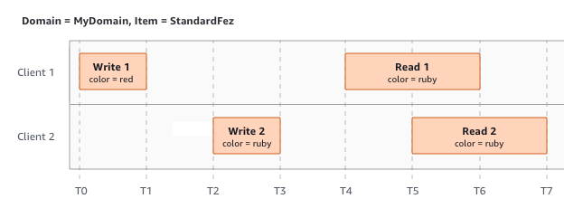
Concurrent applications
When multiple clients are writing to the same items

Slide 48
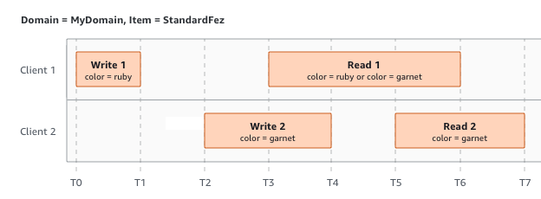
Concurrent applications
W2 does not finish before the start of R1. Therefore, R1 might return color = ruby or color = garnet
The first GET request must happen after all PUT requests have finished to guarantee the latest object.

Slide 49
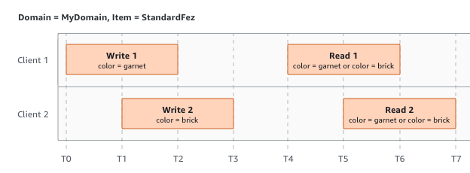
Concurrent applications - concurrent writes
W2 begins before W1 has received an acknowledgment
Amazon S3 internally uses last-writer-wins semantics to determine which write takes precedence
In this scenario, S3 uses last-write wins semantics. But our GET request will return mixed results until the final write finishes.

Slide 50
Concurrent applications - concurrent writes
However, the order in which Amazon S3 receives the requests and the order in which applications receive acknowledgments cannot be predicted because of various factors, such as network latency.

Slide 51
Concurrent applications - concurrent writes
For example, W2 might be initiated by an Amazon EC2 instance in the same Region, while W1 might be initiated by a host that is farther away.

Slide 52
Concurrent applications - concurrent writes
The best way to determine the final value is to perform a read after both writes have been acknowledged.

Slide 53
Overview
Cloud Storage types
Amazon S3
Amazon EFS
Amazon EBS
AWS Storage Gateway

Slide 54
Amazon Elastic File System (EFS)
Amazon Elastic File System (EFS) provides a highly scalable, available, and durable file storage that can be used with EC2 instances.
The storage capacity in an EFS file system is elastic and grows or shrinks as you add or delete files. EFS supports the Network File System protocols (NFSv4.1 and NFSv4.0).
EFS file systems are distributed across several storage servers, which enables the file system to grow elastically and support parallel access from multiple EC2 instances.
EFS is designed for use cases such as Big Data and Analytics workloads, Media Processing workflows, Content Management, and Web Serving.
EFS can provide high throughput coupled with read-after-write consistency, low-latency file operations, and shared file access, which is required for such use cases.

Slide 55
EFS Performance Modes
EFS provides two performance modes: (1) General Purpose and (2) Max I/O.
The General Purpose performance mode is suitable for applications requiring low latency such as web serving, content management, and file serving.
The Max I/O performance mode, is optimized for applications where a large number of EC2 instances are accessing the file system.

Slide 56
EFS Throughput Modes
EFS provides two throughput modes: (1) Bursting throughput and (2) Provisioned throughput.
When Bursting throughput mode is used for an EFS file system, the throughput scales as a file system grows. Bursting throughput mode is useful for file-based workloads, which require low levels of throughput for most of the time and high levels of throughput occasionally.
Provisioned throughput mode is useful for applications requiring high levels of throughput than those allowed by the Bursting throughput mode.

Slide 57
Overview
Cloud Storage types
Amazon S3
Amazon EFS
Amazon EBS
AWS Storage Gateway

Slide 58
Amazon Elastic Block Store (EBS)
Amazon Elastic Block Store (EBS) provides block level storage volumes for use with EC2 instances.
EBS is designed for high availability and durability, and the EBS volumes are automatically replicated within an availability zone.
You can attach multiple EBS volumes to an EC2 instance; however, a volume can be attached to only one instance at a time.

Slide 59
EBS Volumes
An EBS Volume is a block-level storage device that can be attached to an EC2 instance. The benefit of using an EBS volume with an EC2 instance is that it can persist independently from the life of the instance. A volume attached to an EC2 instance can be used like any other physical hard drive.
EBS provides various types of volumes that differ in performance characteristics and cost:
Magnetic (standard): Magnetic volumes have low performance characteristics.
General Purpose SSD (gp2): General Purpose SSD volumes offer cost-effective storage that balances price and performance for a wide variety of workloads.
Provisioned IOPS SSD (io1): Provisioned IOPS SSD volumes are the highest-performance volumes designed for mission-critical low-latency or high-throughput workloads.
Cold HDD (sc1): Cold HDD volumes are designed for less frequently accessed workloads.
Throughput Optimized HDD (st1): Throughput Optimized HDD volumes are designed for frequently accessed, throughput-intensive workloads.

Slide 60
Overview
Cloud Storage types
Amazon S3
Amazon EFS
Amazon EBS
AWS Storage Gateway

Slide 61
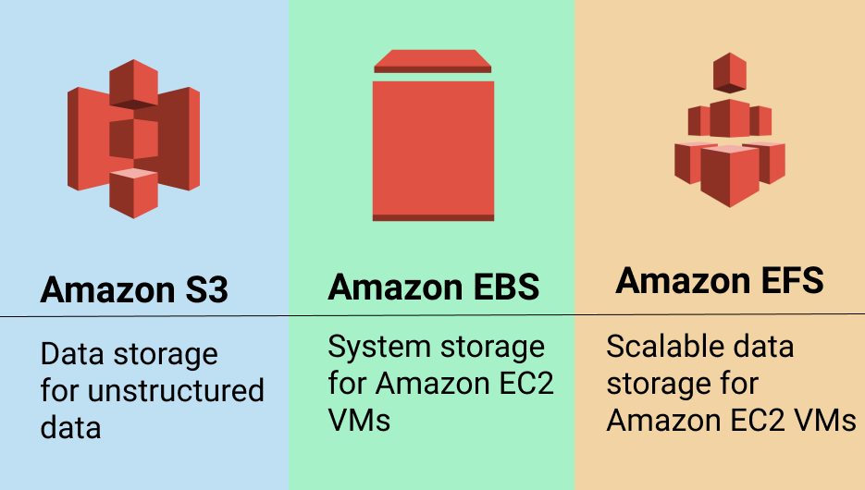
S3 vs EBS vs EFS

Slide 62
S3 vs EBS vs EFS
Amazon S3 (Amazon Simple Storage Service) is an object storage designed for storing large numbers of user files and backups.
Amazon EFS (Amazon Elastic File System) provides scalable network file storage for Amazon EC2 cloud computing service users.
Amazon EBS (Amazon Elastic Block Storage) is block storage for Amazon EC2 compute instances - it is similar to hard drives attached to your computers or laptops, but in a virtualized environment.

Slide 63
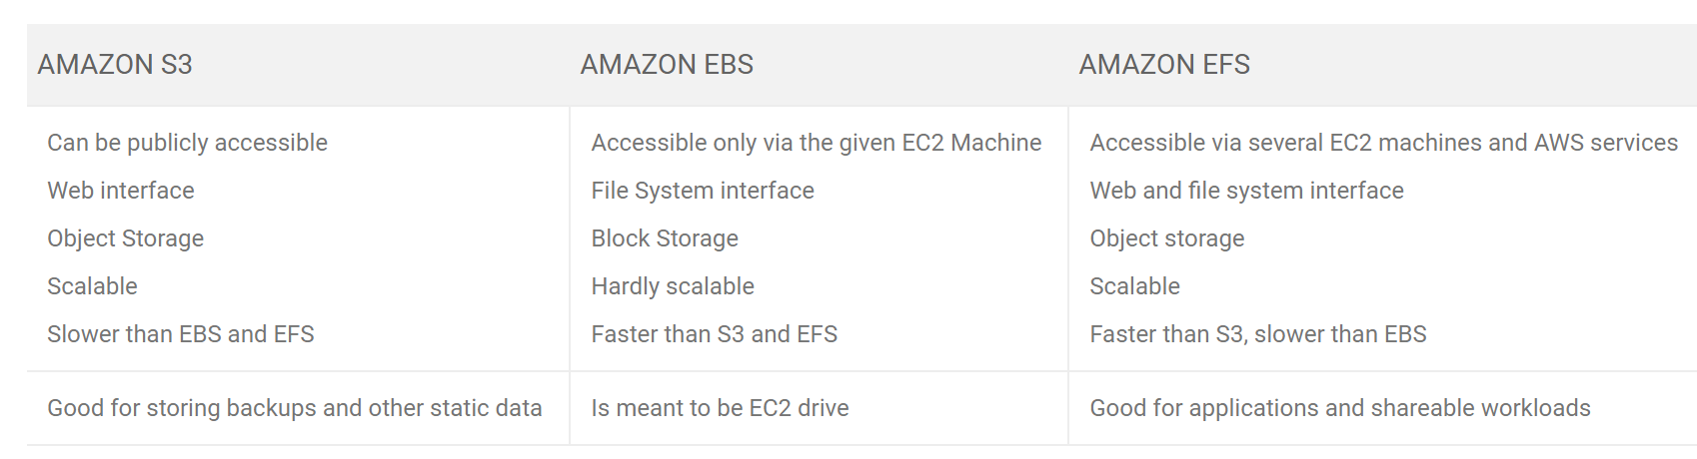
S3 vs EBS vs EFS

Slide 64
Overview
Cloud Storage types
Amazon S3
Amazon EFS
Amazon EBS
AWS Storage Gateway

Slide 65
AWS Storage Gateway
AWS Storage Gateway is a service connecting an on-premises software appliance with cloud-based storage to provide seamless and secure integration between an organization’s on-premises IT environment and AWS’s storage infrastructure.
You can run Storage Gateway either on-premises as a VM appliance, or as a hardware appliance, or in AWS as an Amazon EC2 instance.
AWS Storage Gateway supports three types of storage solutions:
File Gateway: A file gateway allows you to store files as objects in Amazon S3, with a local cache for low-latency access to your most recently used data.
Volume Gateway: A volume gateway provides cloud-backed storage volumes that you can mount as Internet Small Computer System Interface (iSCSI) devices from your on-premises application servers.
Tape Gateway: Tape gateway allows you to back up your data to Amazon S3 and archive in Amazon Glacier by leveraging your existing tape-based backup software infrastructure.

Slide 66
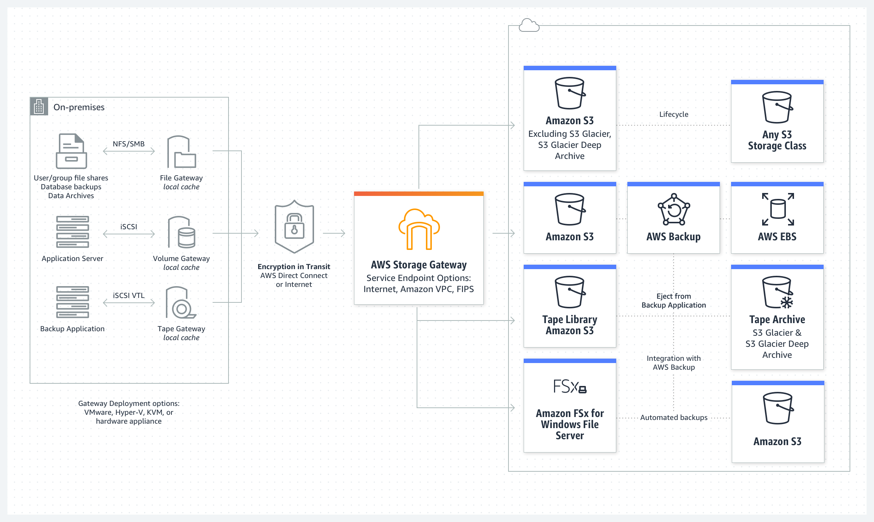
AWS Storage Gateway

Slide 67
AWS Storage Gateway use cases
Hybrid cloud workflows store
File data as objects using data generated by on-premises applications for processing by AWS services such as machine learning or big data analytics.
Migrate application data to EBS
Use a snapshot of your on-premises volumes to recreate the data on EBS and use with Amazon EC2-based applications.
Back up data to the cloud
Provide cloud-based backup for on-premises files and database applications for low-cost, virtually unlimited scale.

Slide 68
Overview
Cloud Storage types
Amazon S3
Amazon EFS
Amazon EBS
AWS Storage Gateway

Slide 69
Core Cloud Service Categories
Cloud Compute Services
Cloud Networking Services
Cloud Storage Services
Cloud Security, Identity, and Compliance Services
Cloud Analytics Services
Cloud Database Services

Slide 70
Big Data Analytics
in the Cloud

Slide 71
Outline
What is Analytics?
What is Big Data?
Characteristics of Big Data
Domain Specific Examples of Big Data
Analytics Flow for Big Data
Big Data Stack
Mapping Analytics Flow to Big Data Stack
Analytics Patterns

Slide 72
What is Analytics?
Analytics is a broad term that encompasses the processes, technologies, frameworks and algorithms to extract meaningful insights from data.
Raw data in itself does not have a meaning until it is contextualized and processed into useful information.
Analytics is this process of extracting and creating information from raw data by ﬁltering, processing, categorizing, condensing and contextualizing the data.
This information obtained is then organized and structured to infer knowledge about the system and/or its users, its environment, and its operations and progress towards its objectives, thus making the systems smarter and more efficient.

Slide 73
The Seven Giants
The National Research Council has done a characterization of computational tasks for massive data analysis (called the seven “giants").
These computational tasks include:
(1) Basis Statistics,
(2) Generalized N-Body Problems,
(3) Linear Algebraic Computations,
(4) Graph-Theoretic Computations,
(5) Optimization,
(6) Integration
(7) Alignment Problems.
This characterization of computational tasks aims to provide a taxonomy of tasks that have proved to be useful in data analysis and grouping them roughly according to mathematical structure and computational strategy.

Slide 74
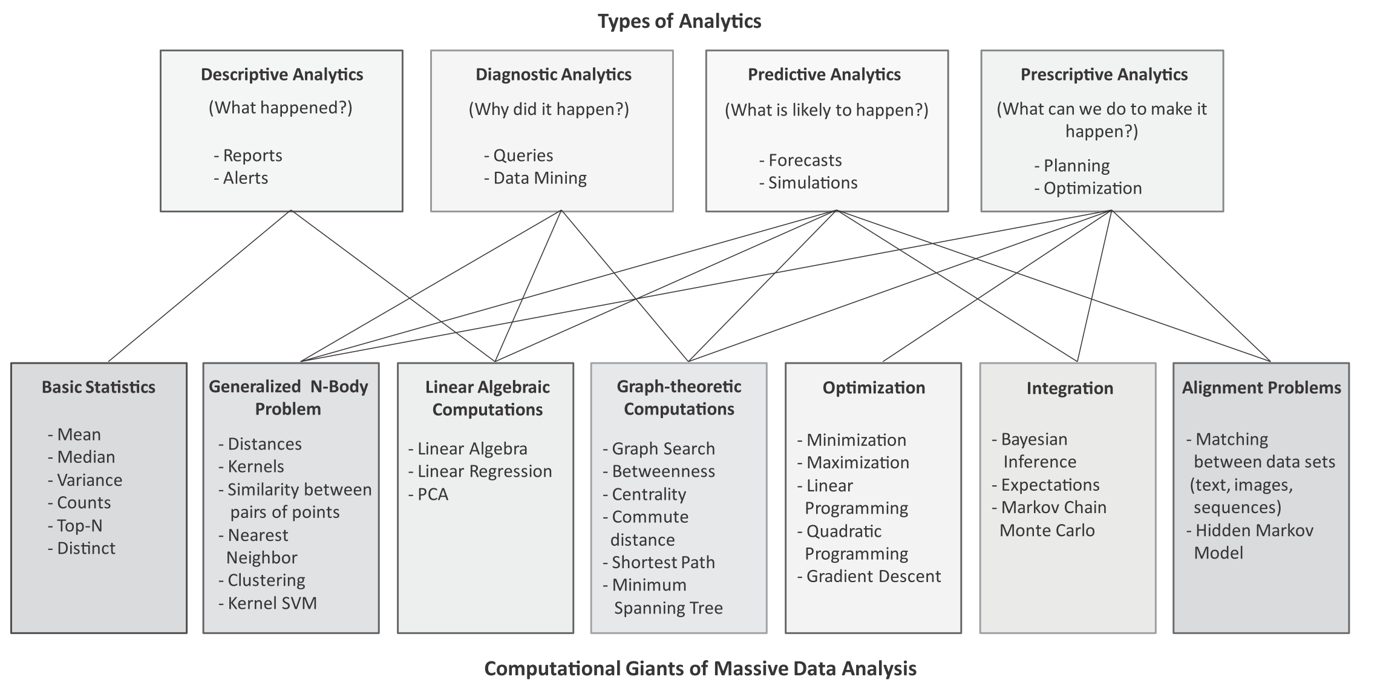
Mapping between types of analytics and computational tasks or ‘giants’

Slide 75
Types of Analytics
Descriptive Analytics
Descriptive analytics comprises analyzing past data to present it in a summarized form which can be easily interpreted. Descriptive analytics aims to answer - What has happened? A major portion of analytics done today is descriptive analytics through use of statistics functions such as counts, maximum, minimum, mean, top-N, percentage, for instance. These statistics help in describing patterns in the data and present the data in a summarized form.
Diagnostic Analytics
Diagnostic analytics comprises analysis of past data to diagnose the reasons as to why certain events happened. Diagnostic analytics aims to answer - Why did it happen? While descriptive analytics can be useful for summarizing the data by computing various statistics (such as mean, minimum, maximum, variance, or top-N), diagnostic analytics can provide more insights into why certain a fault has occurred based on the patterns in the sensor data for previous faults.

Slide 76
Types of Analytics
Predictive Analytics
Predictive analytics comprises predicting the occurrence of an event or the likely outcome of an event or forecasting the future values using prediction models. Predictive analytics aims to answer - What is likely to happen? Predictive Analytics is done using predictive models which are trained by existing data. These models learn patterns and trends from the existing data and predict the occurrence of an event or the likely outcome of an event (classiﬁcation models) or forecast numbers (regression models).
Prescriptive Analytics
While predictive analytics uses prediction models to predict the likely outcome of an event, prescriptive analytics uses multiple prediction models to predict various outcomes and the best course of action for each outcome. Prescriptive analytics aims to answer - What can we do to make it happen? Prescriptive Analytics can predict the possible outcomes based on the current choice of actions.

Slide 77
What is Big Data?
Big data is deﬁned as collections of datasets whose volume, velocity or variety is so large that it is difﬁcult to store, manage, process and analyze the data using traditional databases and data processing tools.
According to an estimate by IBM, 2.5 quintillion bytes of data is created every day.
A recent report by DOMO estimates the amount of data generated every minute on popular online platforms. Below are some key pieces of data from the report:
Facebook users share nearly 4.16 million pieces of content
Twitter users send nearly 300,000 tweets
Instagram users like nearly 1.73 million photos
YouTube users upload 300 hours of new video content
Apple users download nearly 51,000 apps
Skype users make nearly 110,000 new calls
Amazon receives 4300 new visitors
Uber passengers take 694 rides
Netﬂix subscribers stream nearly 77,000 hours of video

Slide 78
Big Data Analytics
Big Data analytics deals with collection, storage, processing and analysis of this massive-scale data.
Big data analytics involves several steps starting from data cleansing, data munging (or wrangling), data processing and visualization.
Specialized tools and frameworks are required for big data analysis when:
the volume of data involved is so large that it is difﬁcult to store, process and analyze data on a single machine,
the velocity of data is very high and the data needs to be analyzed in real-time,
there is variety of data involved, which can be structured, unstructured or semi-structured, and is collected from multiple data sources,
various types of analytics need to be performed to extract value from the data such as descriptive, diagnostic, predictive and prescriptive analytics.

Slide 79
Big Data Examples
Data generated by social networks including text, images, audio and video data
Click-stream data generated by web applications such as e-Commerce to analyze user behavior
Machine sensor data collected from sensors embedded in industrial and energy systems for monitoring their health and detecting failures
Healthcare data collected in electronic health record (EHR) systems
Logs generated by web applications
Stock markets data
Transactional data generated by banking and ﬁnancial applications

Slide 80
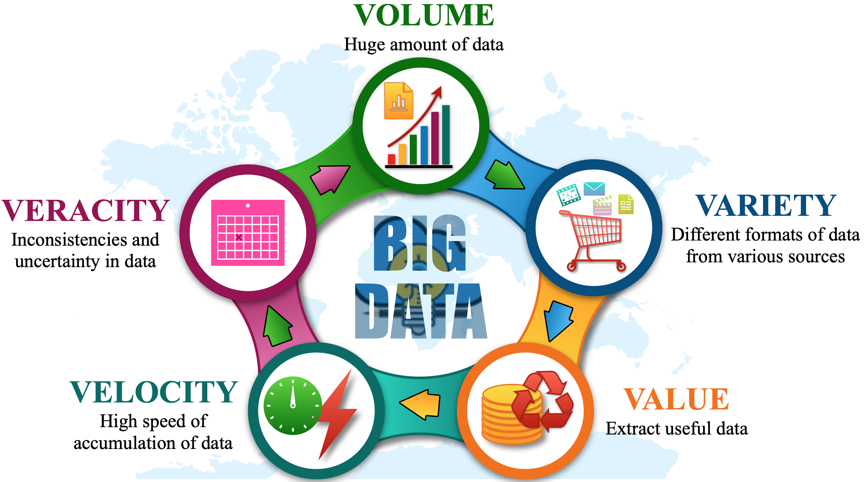
Characteristics of Big Data

Slide 81
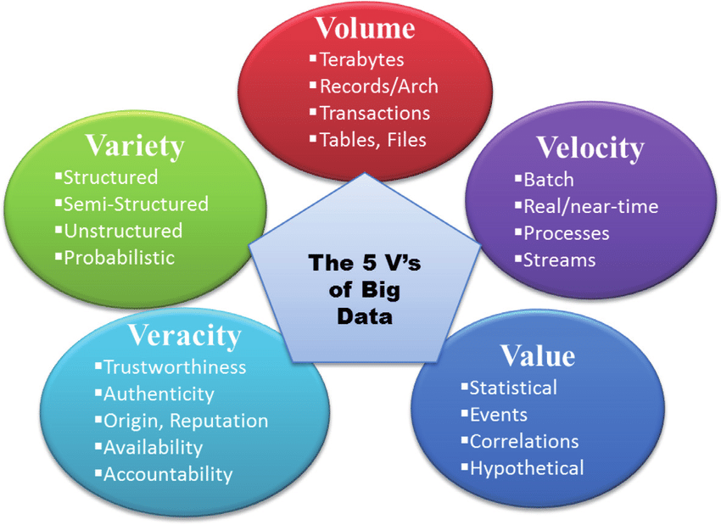

Slide 82
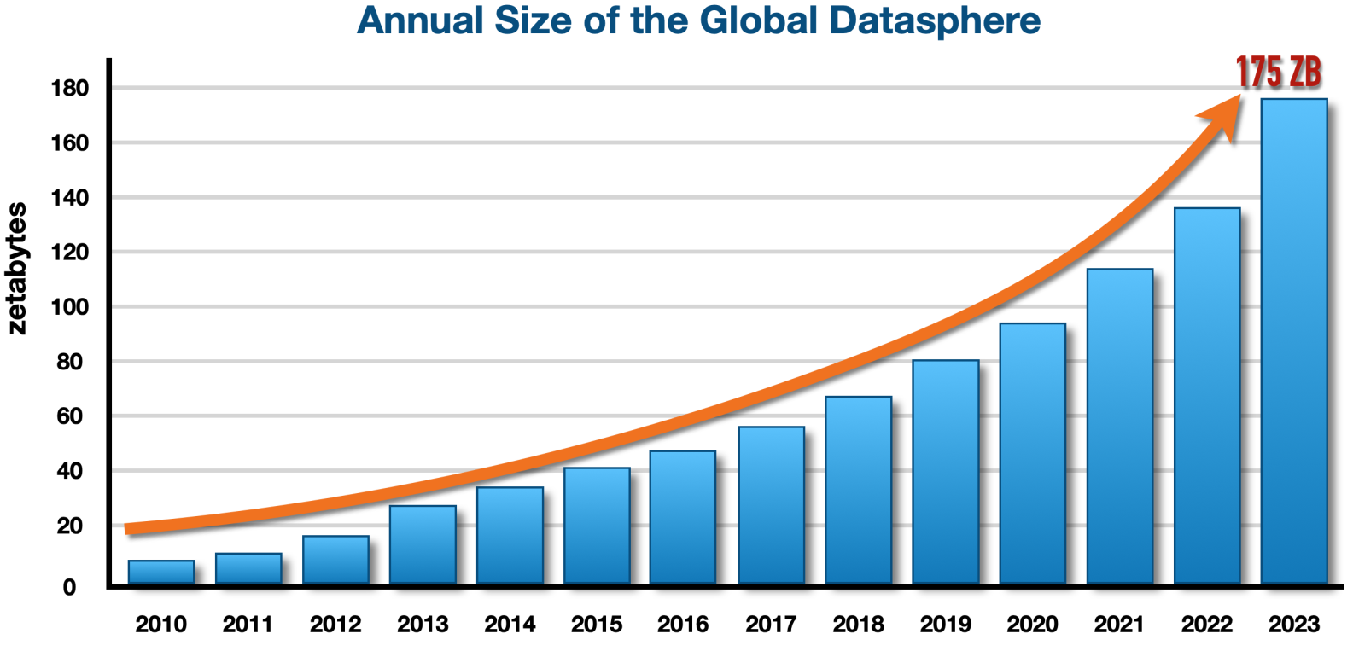
Characteristics of Big Data
Volume
Big data is a form of data whose volume is so large that it would not ﬁt on a single machine therefore specialized tools and frameworks are required to store process and analyze such data.

Slide 83
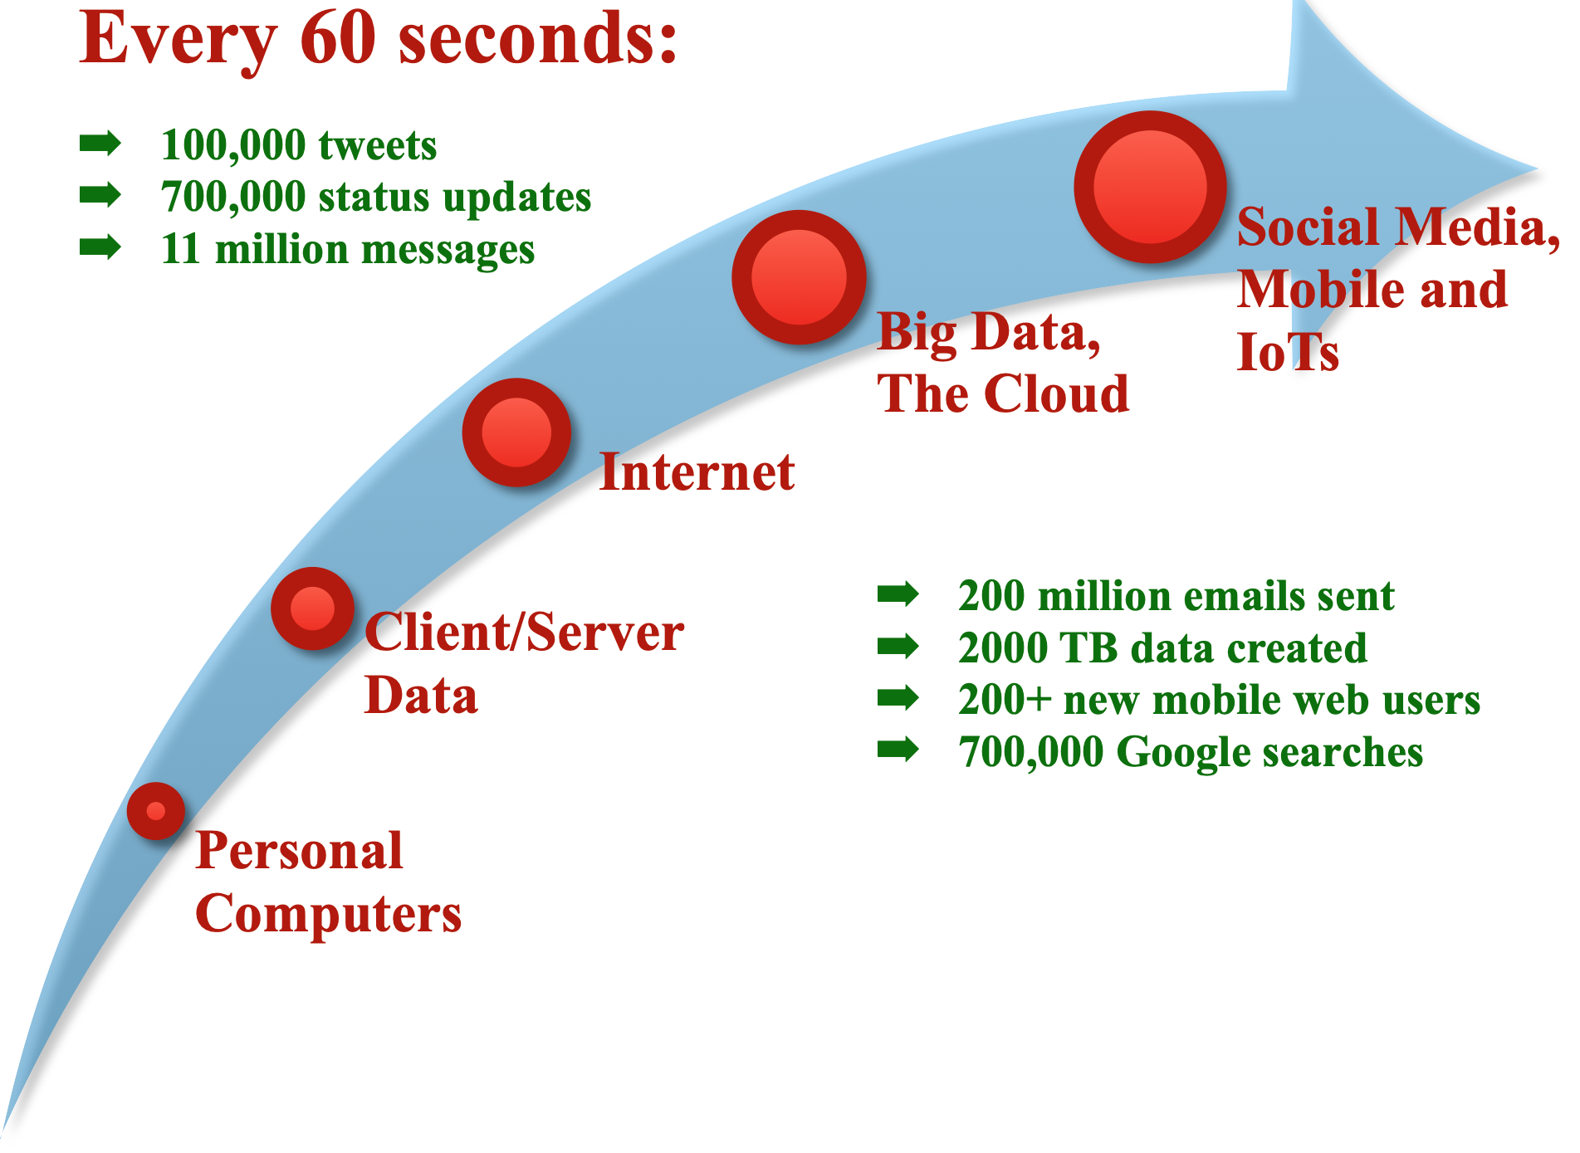
Characteristics of Big Data
Velocity
Velocity of data refers to how fast the data is generated. Data generated by certain sources can arrive at very high velocities, for example, social media data or sensor data.

Slide 84
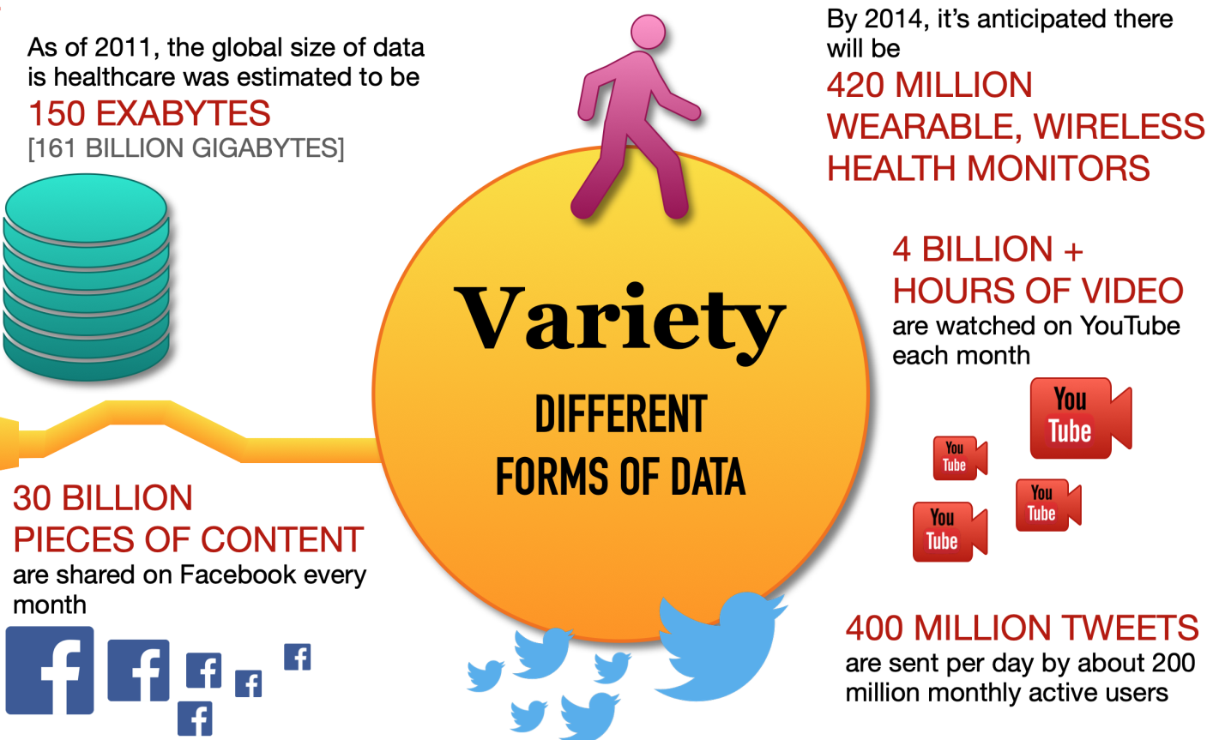
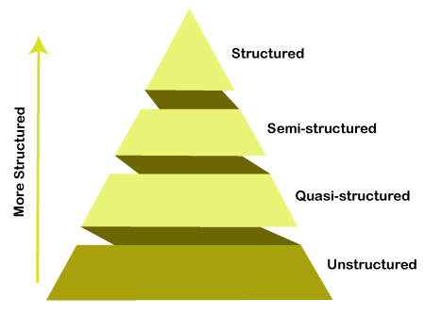
Characteristics of Big Data
Variety
Variety refers to the forms of the data. Big data comes in different forms such as structured, unstructured or semi-structured, including text data, image, audio, video and sensor data.

Slide 85
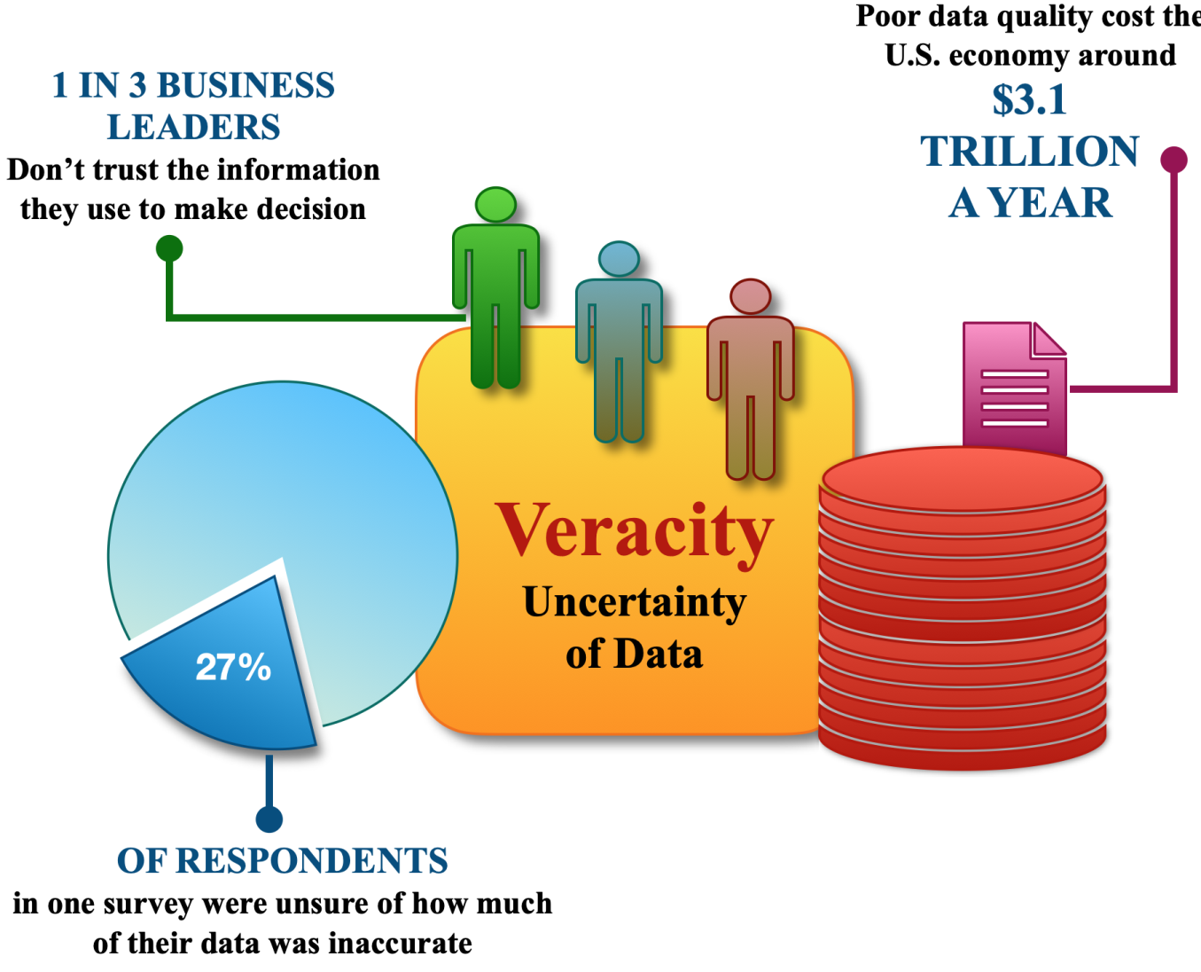
Characteristics of Big Data
Veracity
Veracity refers to how accurate is the data. To extract value from the data, the data needs to be cleaned to remove noise.

Slide 86
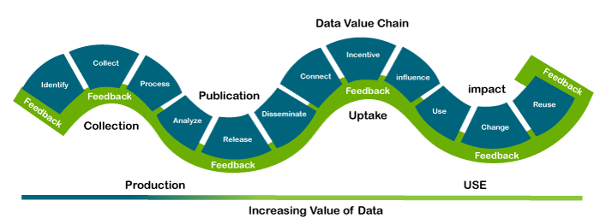
Characteristics of Big Data
Value
Value of data refers to the usefulness of data for the intended purpose. The end goal of any big data analytics system is to extract value from the data

Slide 87
Domain Speciﬁc Examples of Big Data
Web
Financial
Healthcare
Internet of Things
Environment
Logistics & Transportation
Industry
Retail

Slide 88
Domain Speciﬁc Examples of Big Data
Web
Web Analytics
Insights about web visitor engagement and tracking performance of online advertisement campaigns
Performance Monitoring
Predict application performance under heavy workloads and identify bottlenecks in the system
Ad Targeting and Analytics
Matching advertisements to the users and generating advertisement statistics reports
Content Recommendation
Recomending new content to the user based on user preferences and interests

Slide 89
Domain Speciﬁc Examples of Big Data
Financial
Credit Risk Modelling
Score credit applications and predict if a borrower will default or not in the future
Fraud Detection
Credit card frauds
Money laundering
Insurance claim frauds

Slide 90
Domain Speciﬁc Examples of Big Data
Healthcare
Patient similarity-based decision intelligence application
Analyse EHR data to extract a cluster of patient records most similar to a particular target patient
Adverse drug events prediction
Which patients are most at risk for having an adverse response to a certain drug based on adverse drug reactions of other patients
Real-time health monitoring
Analyse data from wearable devices to determine any health conditions or anomalies

Slide 91
Domain Speciﬁc Examples of Big Data
Internet of Things
Intrusion detection
Use data from security cameras and sensors to detect intrusions and raise alerts
Smart parking
Detect number of empty parking slots
Smart roads
Information on driving conditions, traffic congestions, accidents
Structural health monitoring
By monitoring vibration levels of structures such as bridges and buildings, detect cracks, mechanical breakdowns, damages to the structure, caclulate the remaining life of the structure

Slide 92
Domain Speciﬁc Examples of Big Data
Environment
Weather monitoring
Air pollution monitoring
Noise pollution monitoring
Forest fire detection
River floods detection
Water quality measuring

Slide 93
Domain Speciﬁc Examples of Big Data
Logistics & Transportation
Real time fleet tracking
Shipment monitoring
Remote vehicle diagnosis
Route generation and scheduling

Slide 94
Domain Speciﬁc Examples of Big Data
Industry
Machine diagnosis and prognosis
Risk analysis of industrial operations
Production planning and control

Slide 95
Domain Speciﬁc Examples of Big Data
Retail
Inventory management
Customer recommendations
Store layout optimization
Forecasting demand

